Slide 1
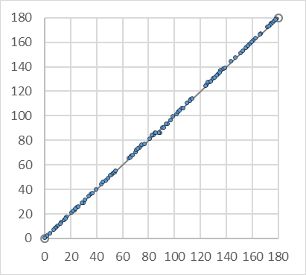
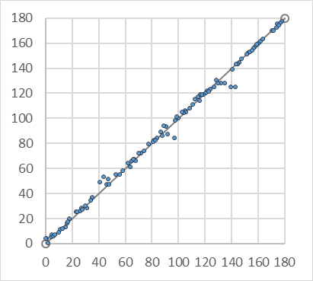
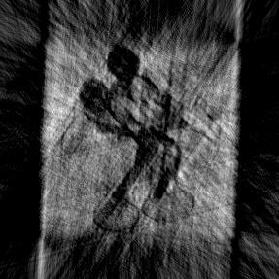
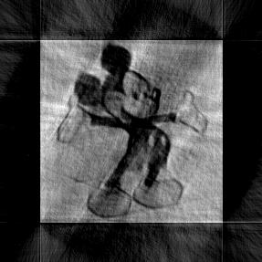
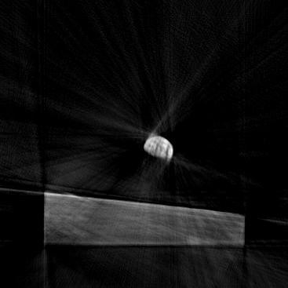
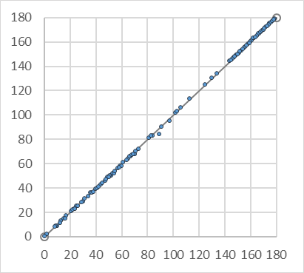
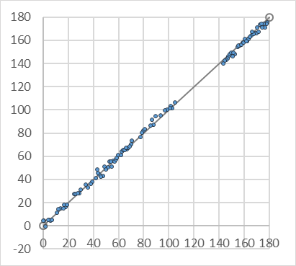
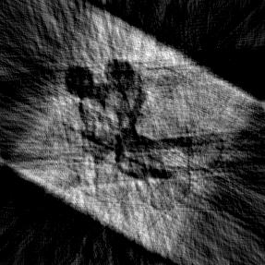
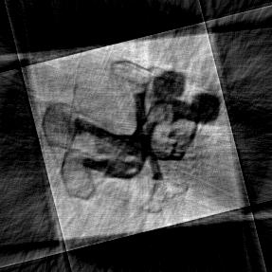
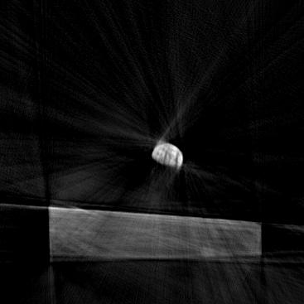
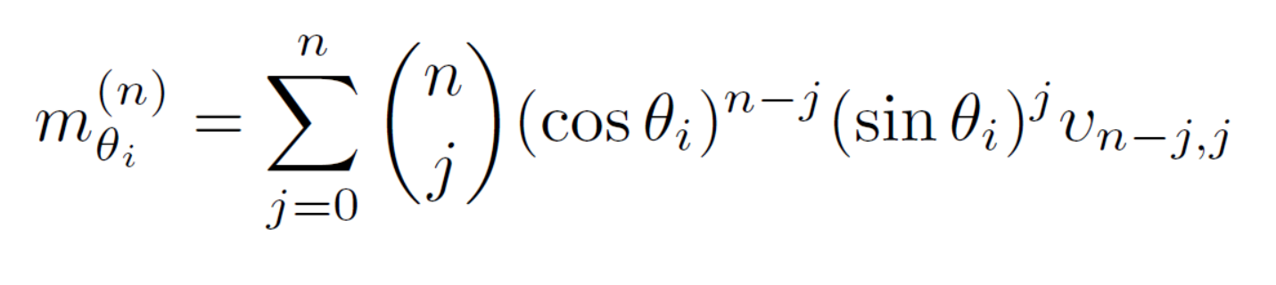
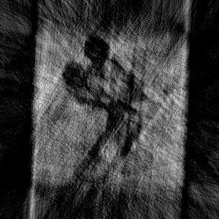
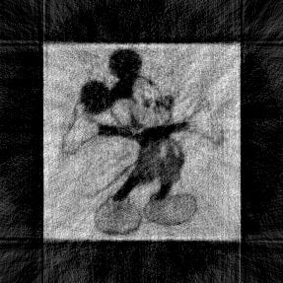

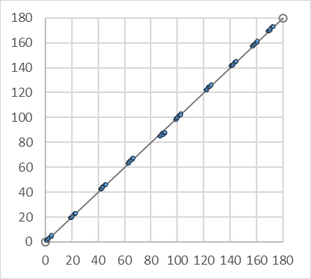
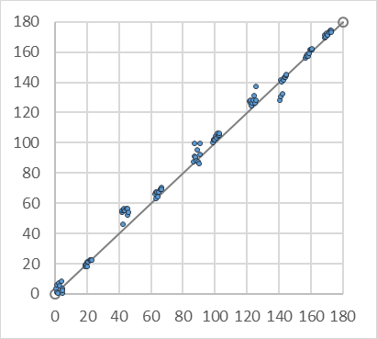
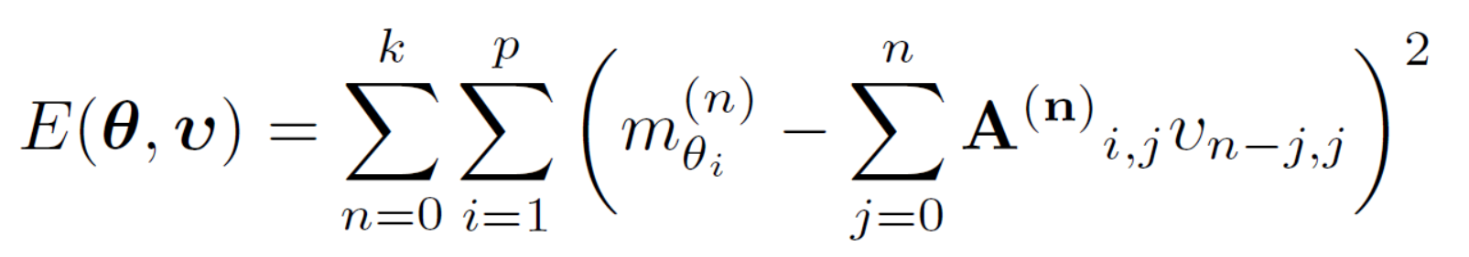
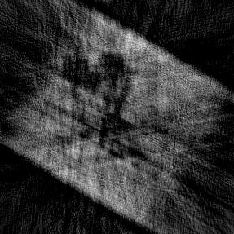
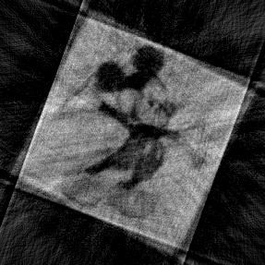
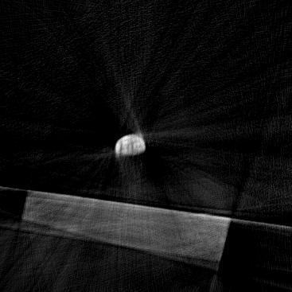
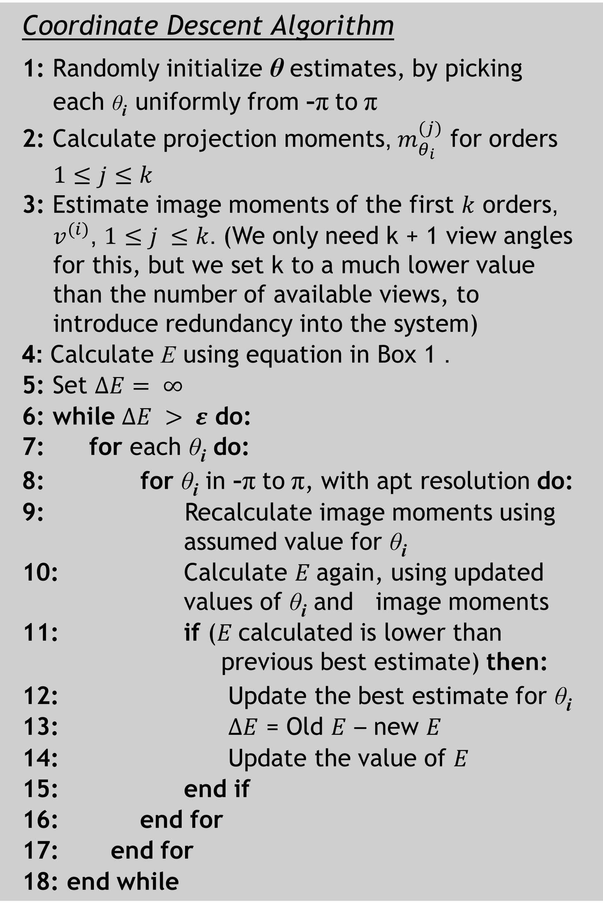
Tomographic Reconstruction from Projections with Unknown View Angles Exploiting Moment-Based Relationships
Eeshan Malhotra, Ajit Rajwade
Indian Institute of Technology Bombay
Introduction
Algorithm - Denoising
Results - Angle Recovery
Results - Reconstruction
View-angles for tomographic projections are often noisy/unknown
We recover view-angles in the scenario when they are completely unknown, with no assumption on angle distribution
We utilize the Helgasson-Ludwig Consistency Conditions (HLCC) - relationship between the geometric moments of the image and projections from a given angle
To obtain consistent estimates for view-angles, θ, and the corresponding image moments, we minimize
Coordinate descent strategy used – iteratively minimized each θ_{i} to converge at best estimate
Multiple starts to avoid local minima
Patch-based PCA denoising method
Fixed size patches from the (noisy) tomographic projections considered in a moving window along each projection
For set of L ‘most similar’ patches to patch p eigen-coefficients obtained using PCA
For denoising, Wiener-like updates performed on each patch
Patch approach captures similarity even in non-analogous parts of two projections
Works well even when total number of projections is very low
Recovered angle vs Actual angle (corrected offset)
FBP reconstruction using non-uniform distribution of original angles
Image: Earthrise
Image: Mickey
30 angles
100 angles
100 angles
Uniform Distribution
5% noise
Actual Angles
Non-uniform Distribution
5% noise
Estimated Angles
Algorithm – Angle Recovery
Coordinate Descent Algorithm
1: Randomly initialize θ estimates, by picking each θ_{i} uniformly from -π to π
2: Calculate projection moments, $m_{θ_{i}}^{(j)}$ for orders $1≤j≤k$
3: Estimate image moments of the first $k$ orders, $v_{ }^{(i)}$, $1≤j ≤k$. (We only need k + 1 view angles for this, but we set k to a much lower value than the number of available views, to introduce redundancy into the system)
4: Calculate E using equation in Box 1 .
5: Set $∆E= ∞$
6: while $∆E > ε$ do:
7: for each θ_{i} do:
8: for θ_{i} in -π to π, with apt resolution do:
9: Recalculate image moments using assumed value for θ_{i}
10: Calculate $E$again, using updated values of θ_{i} and image moments
11: if ($E$calculated is lower than previous best estimate) then:
12: Update the best estimate for θ_{i}
13: $∆E$ = Old $E$ – new $E$
14: Update the value of $E$
15: end if
16: end for
17: end for
18: end while
10% noise
Actual Angles
Peaky Distribution
10% noise
Estimated Angles
Image size: 200x200; View angles: 100; Noise level: 10%; Moment order k ≤ 5; #Starts (θ estimates): 10
Conclusions
(Compare Row2 to Row1, Row4 to Row3) Image size: 200x200; Moment order k ≤ 5; #Starts (θ estimates): 10
Proposed a general, robust method for image reconstruction from projections from unknown views
Empirically demonstrated efficiency in a variety of scenarios: (1) With varying number of view angles (2) With different distributions for generation of the view angles (3) At multiple noise levels
Key idea: Iteratively improve angle estimates to reduce residuals in HLCC, using coordinate descent
Applications in CryoEM, insect tomography, correcting for patient motion in medical tomography
Contributions
Key References
Assumes no prior knowledge of distribution angles (as opposed to [1],[2],[3],[4])
Requires very few projections – accurate recovery with as few as 30 view-angles (see results); Existing techniques ([1],[2],[3]) require hundreds of view angles
Principled technique which is empirically robust to noise
Basu and Bresler, Feasibility of tomography with unknown view angles, IEEE Transactions on Image Processing, 2000
Singer and Wu, Two-dimensional Tomography from Noisy Projections Taken at Unknown Random Directions, SIAM Journal on Imaging Sciences, 2013
Coifman et al, Graph Laplacian Tomography from Unknown Random Projections, IEEE Transactions on Image Processing, 2008
Fang et al, sLLE: Spherical Locally Linear Embedding with Applications to Tomography, CVPR, 2011

